Slide 1
Convolutional Neural Networks ( CNN )
Neural Network and Fuzzy System: Week 09

Slide 2
Content
Introduction
Architectural Overview
ConvNet Layers
Convolutional Layer
ReLU Layer
Pooling Layer
Fully-connected Layer
Demo

Slide 3
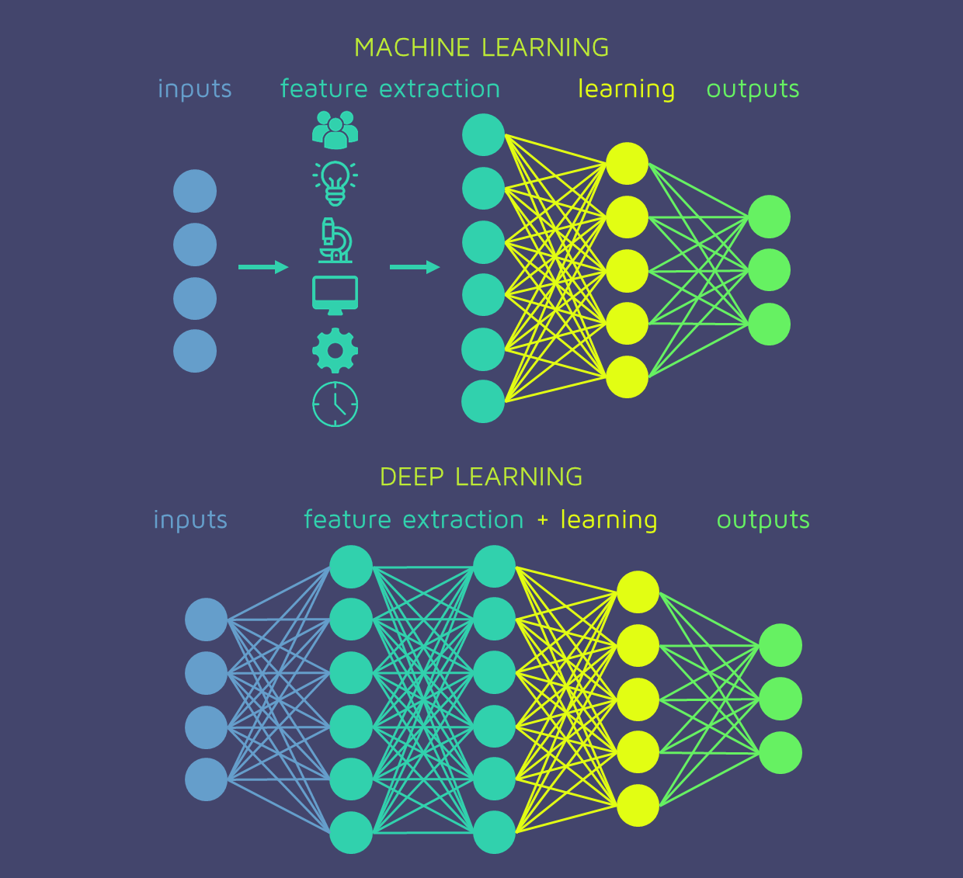
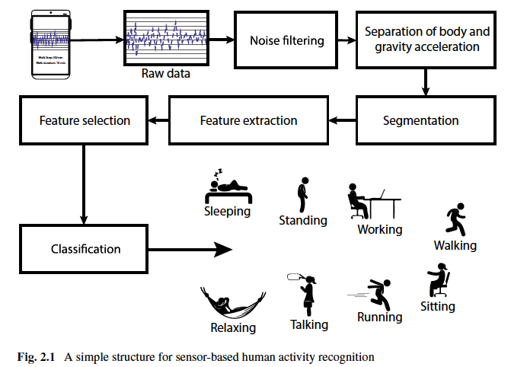
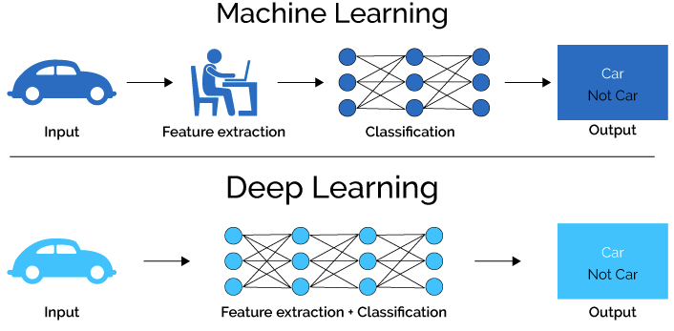
Deep Learning vs Machine Learning
Detailed ML structure
[Book: IoT Sensor-Based Activity Recognition]

Slide 4
Deep Learning vs Machine Learning Cont.
Data Consumption
DL: vast labelled quality samples
ML: can train on lesser data
Dedicated Hardware
DL: Requires GPU to reduce execution time (i.e. hours, days or weeks vs. years)
ML: Trains on CPU
Feature Extraction
ML: Hand-crafted complex features extracted by human (Domain Expertise)
DL: Learns important features without hard coding by a human
Computational Cost
ML: Cheaper in time to execute
DL: More expensive in time to execute (set-up and run time, hardware, and cost)
Notes:
Feature extraction (Coin Finding problem) (aka feature engineering) is the process of putting domain knowledge into the creation of feature extractors to reduce the complexity of the data and make patterns more visible to learning algorithms.
ML often requires complex feature engineering, which is costly in terms of time and hiring or contracting domain expertise.
DL techniques can eliminate or reduce the need for complex feature extraction, thereby reducing the time and cost of that step, albeit potentially in exchange for more expense in time and money regarding hardware and execution time of DL approaches.

Slide 5
Deep Learning vs Machine Learning Cont.
Adaptability
ML: less adaptable, even within similar domains (domain and application specific techniques needed)
DL: More adaptability to different domains and applications
Interpretability (how and why the ML algorithm arrived at an outcome)
ML: Easy interpretation due to feature engineering and simple models (system correction for incorrect results in unexpected circumstances)
DL: Less capable of interpretation (Blackbox!) (opening up through research)
Performance
ML: Gives lesser accuracy (can vary for situations and other factors)
DL: Provides high accuracy (can vary for situations and other factors)
Notes:
Adaptability:
ML: Both domain specific and application specific ML techniques and feature engineering are required to build high-performance ML models. Therefore the resulting models are less adaptable, even within similar domains. Smartphone vs smartwatch
DL:For example, once one understands the underlying deep learning theory for the domain of speech recognition, then learning how to apply deep networks to natural language processing isn’t too challenging since the baseline knowledge is quite similar.
Interpretability:
ML: it’s easier to understand how and why the ML algorithm arrived at an outcome. This can be incredibly helpful, not to mention necessary (e.g. in regulated environments), to unwind and correct a system that produces incorrect results in unexpected circumstances. This can be incredibly helpful, not to mention necessary (e.g. in regulated environments), to unwind and correct a system that produces incorrect results in unexpected circumstances.
DL: That said, there continue to be significant developments in this area that are opening up the blackbox so this distinction may reduce over time.

Slide 6
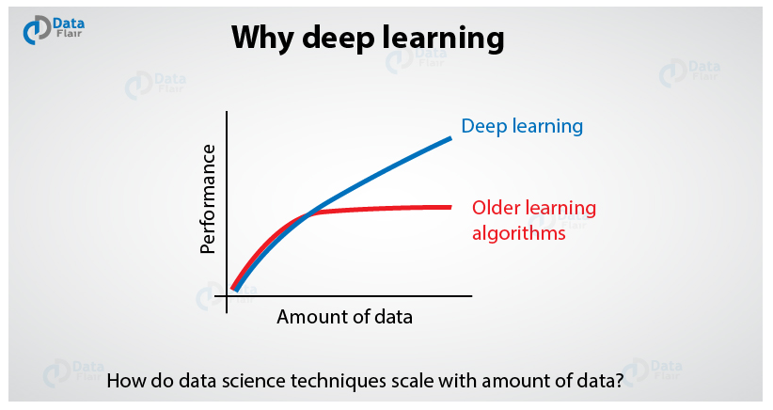
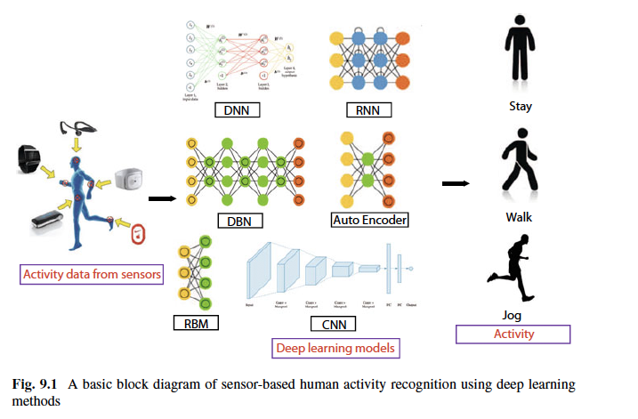
Why Deep Learning?
Amount of data vs performance
Time consuming hand-crafted and domain specific features in ML
Complex task
Static data vs real-time data stream
Problem Solving Approach
Task of multiple object detection (identify what the object is and where is it present in the image)
ML: two-step solution
Object detection (grabcut algorithm)
Object recognition (SVM with HOG to recognize relevant objects)
DL: Deep CNN architecture on raw images
Industry vs Academia (Computer Vision, Information Retrieval, Marketing, Medical Diagnosis)
Notes:
Performance is the main key difference between both algorithms. Although, when the data is small, Deep Learning algorithms don’t perform well. This is the only reason DL algorithms need a large amount of data to understand it perfectly.

Slide 7
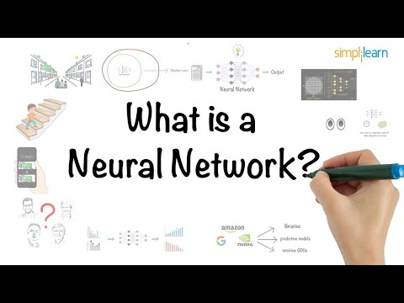
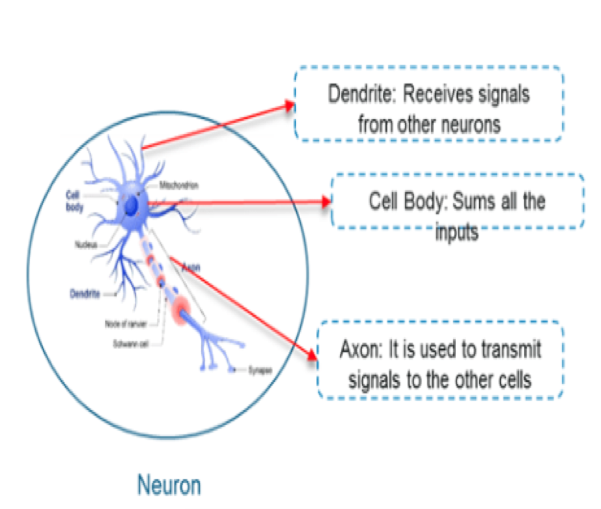
Deep Learning Basics
For more detailed lecture on deep neural networks: Invited talk on “Deep Learning and Artificial Neural Network” (Nov 2018, Kyushu Institute of Technology, Japan)

Slide 8
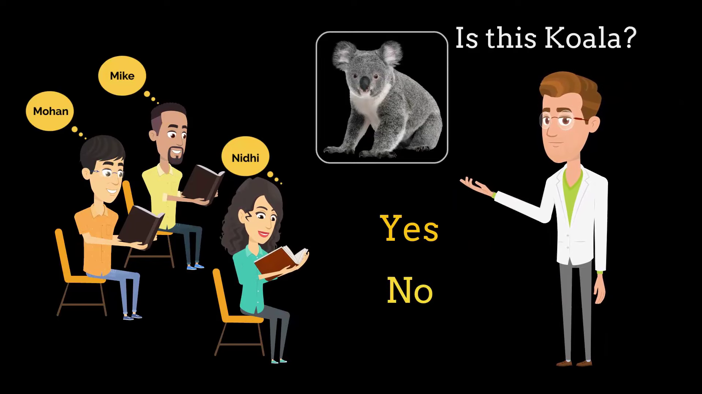

Slide 9
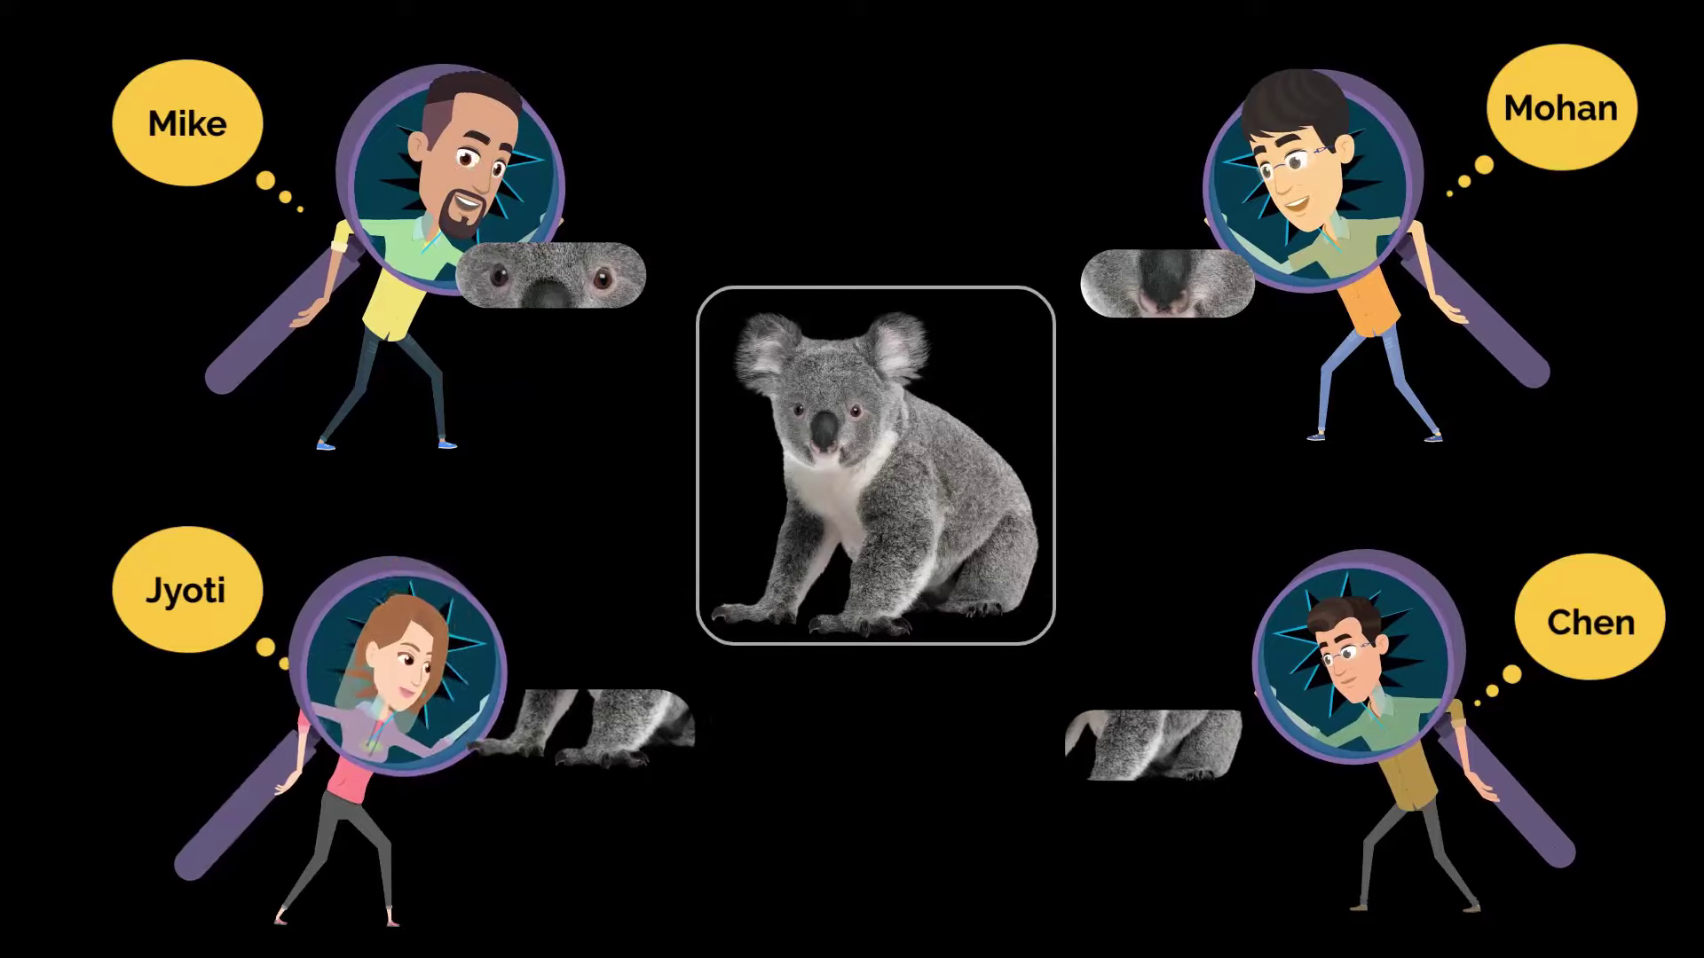

Slide 10
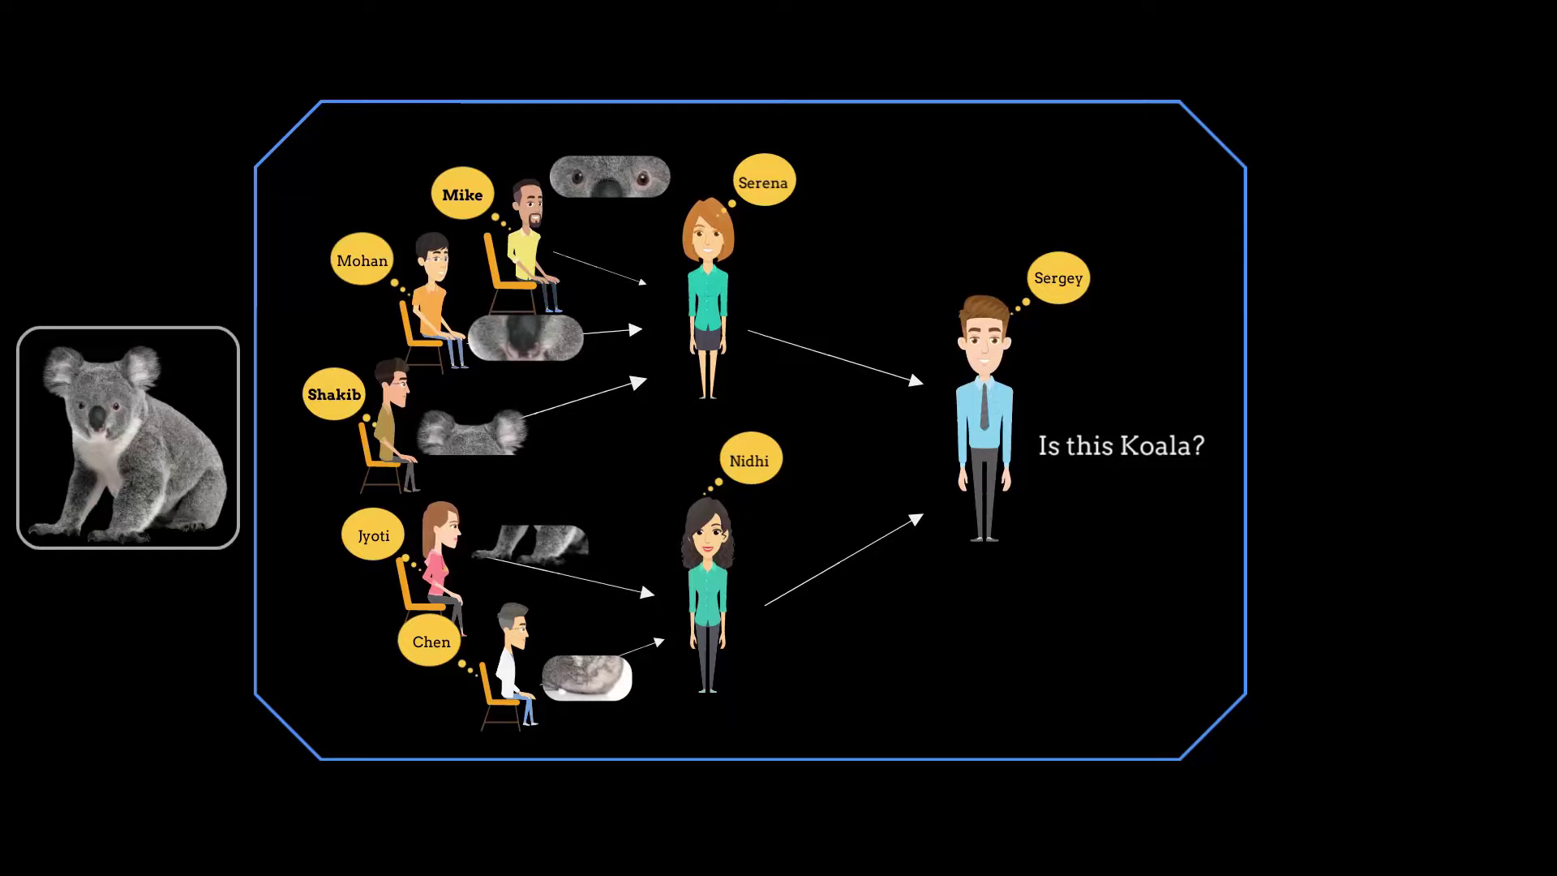

Slide 11
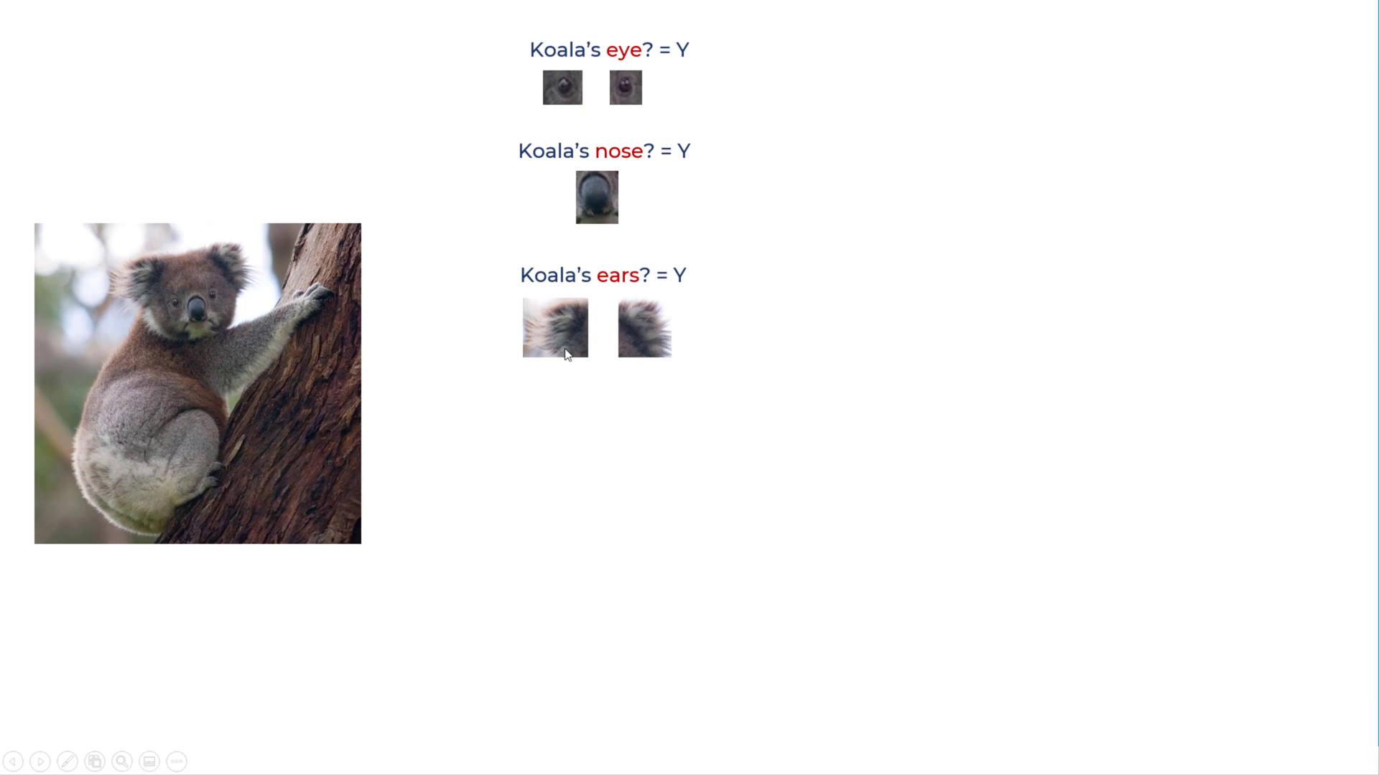

Slide 12
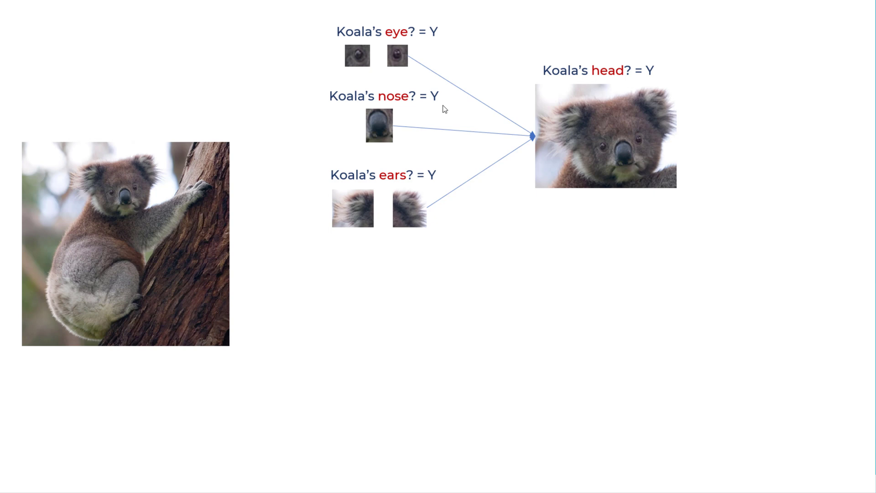

Slide 13
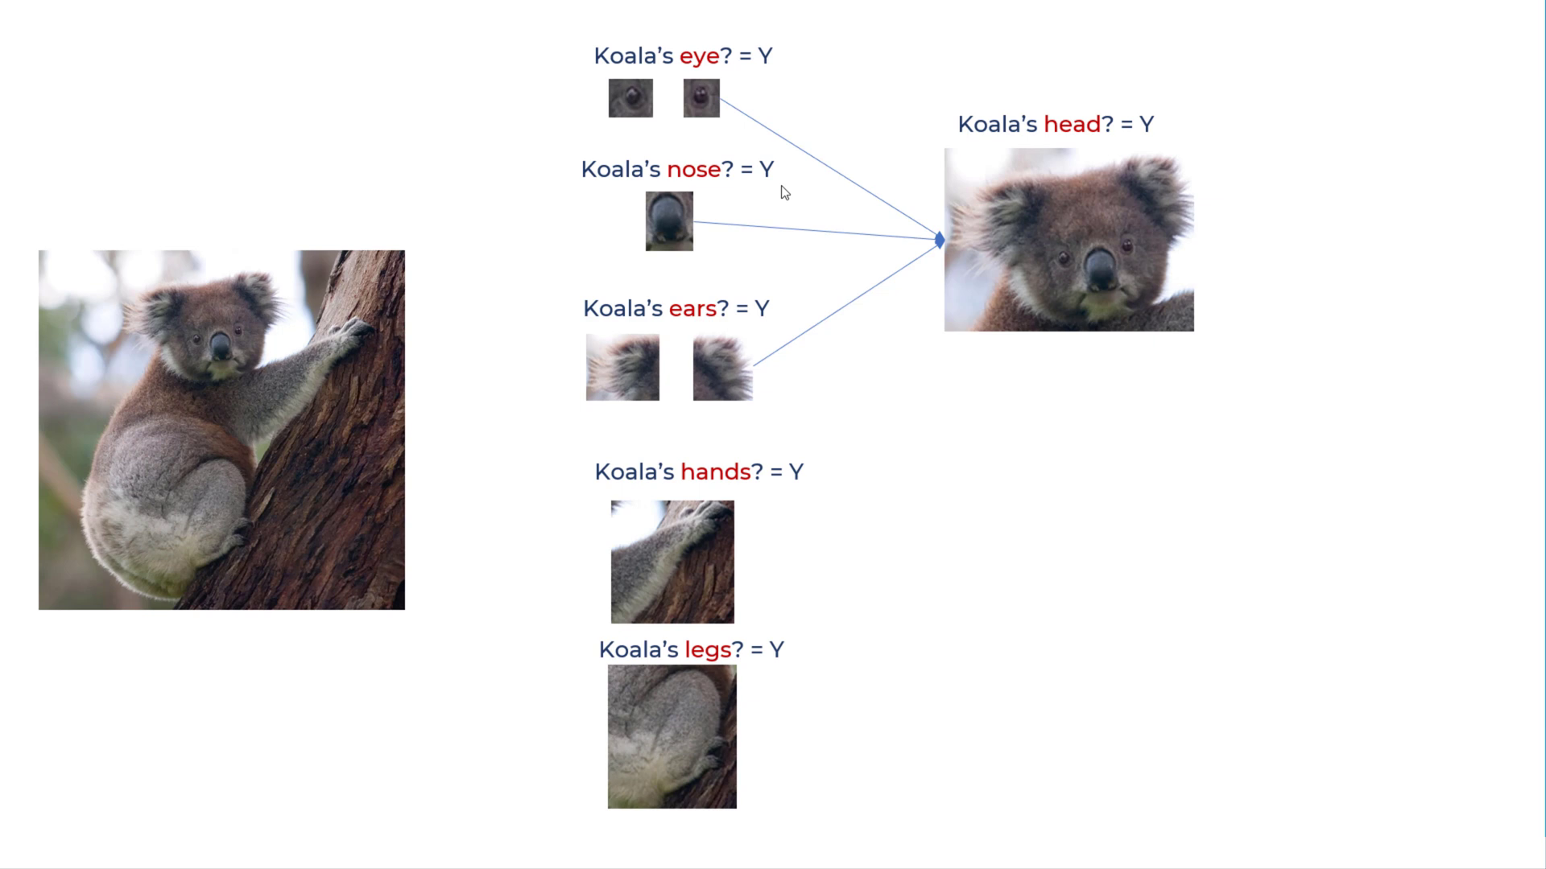

Slide 14
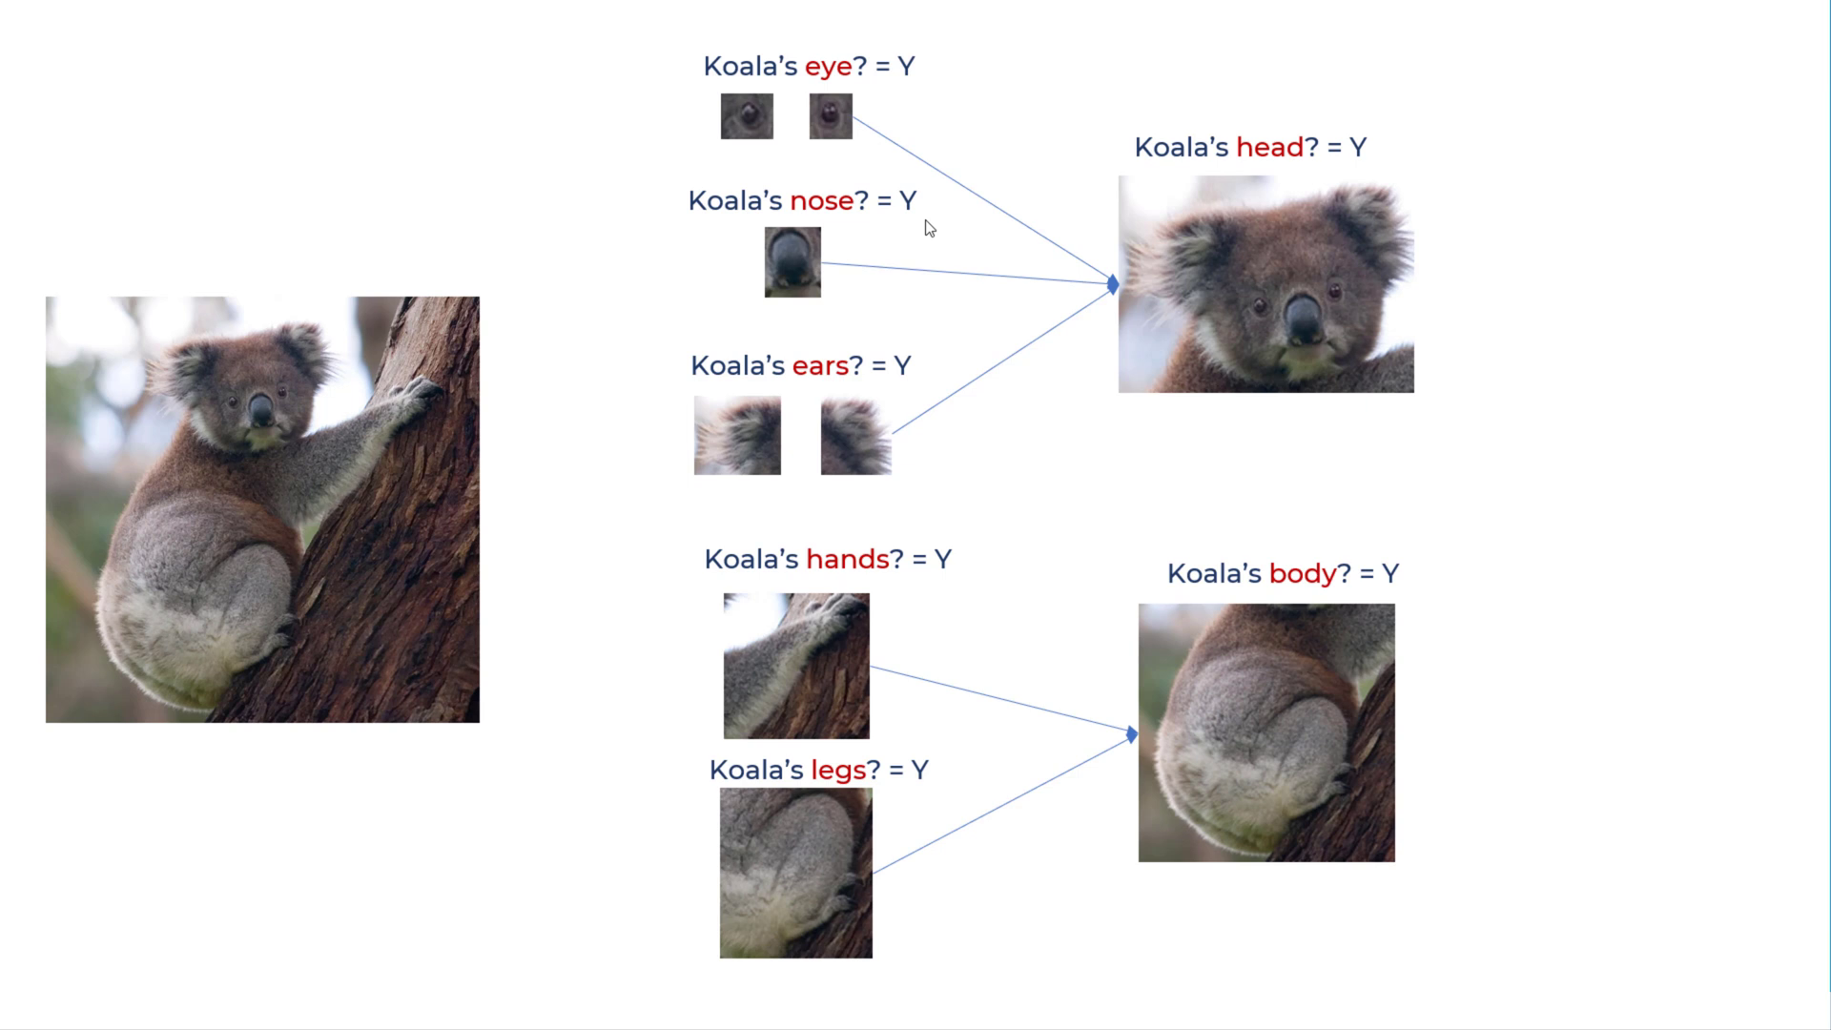

Slide 15
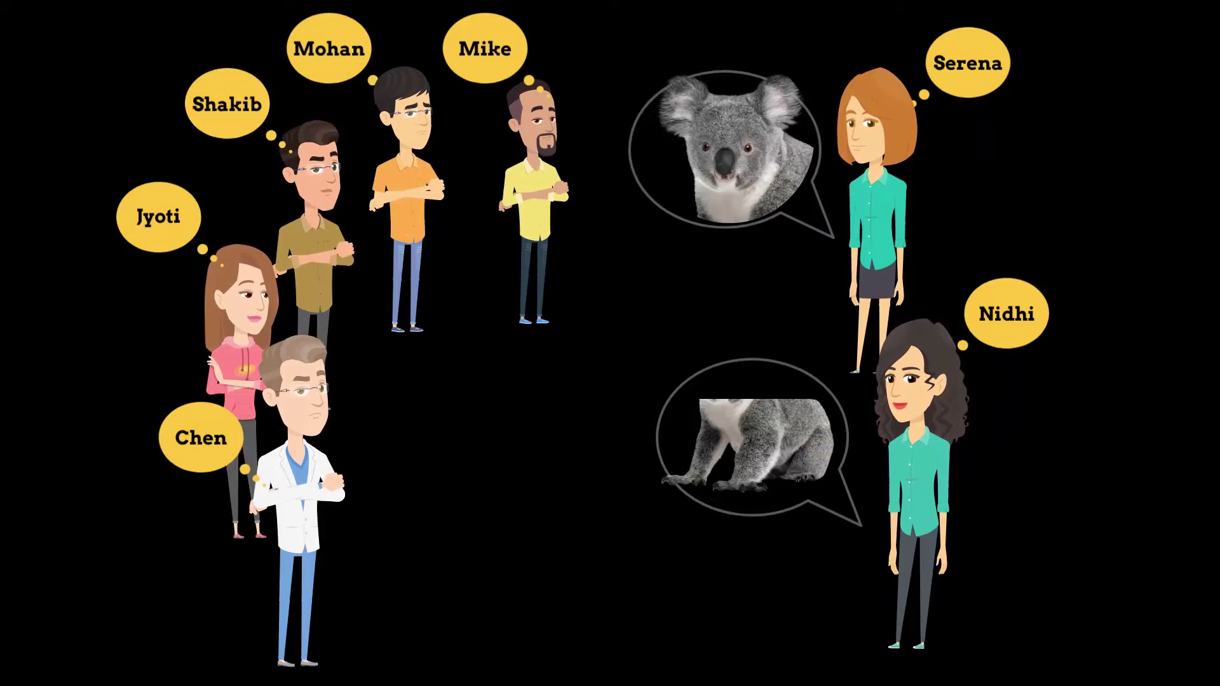

Slide 16
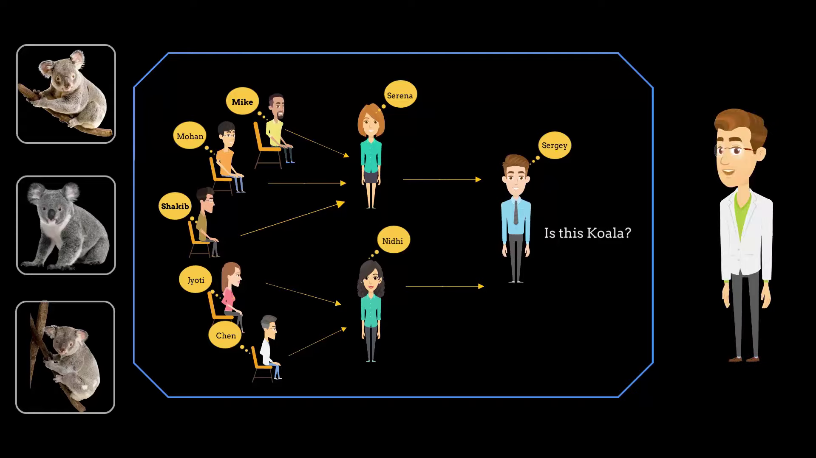
YES

Slide 17

Introduction
The name "convolutional neural network" indicates that the network employs a mathematical operation called convolution.
A CNN is comprised of one or more convolutional layers (often with a pooling step) and then followed by one or more fully connected layers as in a standard multilayer neural network.
The architecture of a CNN is designed to take advantage of the 2D structure of an input image.

Slide 18
Content
Introduction
Architectural Overview
ConvNet Layers
Convolutional Layer
Pooling Layer
Normalization Layer
Fully-connected Layer
Demo

Slide 19
Motivation behind ConvNets
Consider an image of size 200x200x3 (200 wide, 200 high, 3 color channels)
a single fully-connected neuron in a first hidden layer of a regular Neural Network would have 200*200*3
= 120,000 weights.
Due to the presence of several such neurons, this full connectivity is wasteful and the huge number of parameters would quickly lead to overfitting
However, in a CNN, the neurons in a layer will only be connected to a small region of the layer
before it, instead of all of the neurons in a fully-connected manner.
the final output layer would have dimensions 1x1xN, because by the end of the CNN architecture we will reduce the full image into a single vector of class scores (for N classes), arranged along the depth dimension

Slide 20
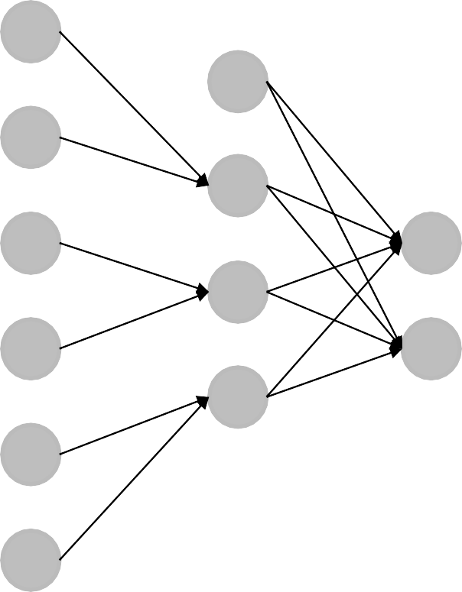
ANN VS CNN
Input
Input
Hidden
Hidden
Output
Output
Convolutional Neural Network With Partially Connected Convolution Layer
Artificial Neural network: All Fully Connected Layers

Slide 21
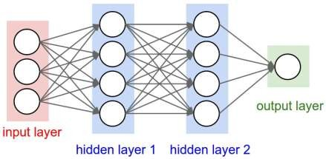
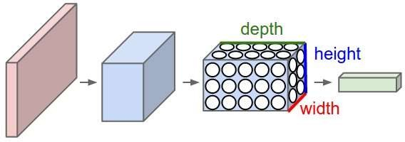
ANN vs CNN
A regular 3-layer Neural
Network.
A CNN arranges its neurons in three dimensions (width, height, depth), as visualized in one of the layers.

Slide 22
How CNN Works
For example, a CNN takes the input as an image which can be classified as ‘X’ or ‘O’
A two-dimensional array of pixels
CNN
X or O
In a simple case, ‘X’ would look like:

Slide 23


How CNN Works
What about trickier cases?
CNN
X
CNN
O

Slide 24
?
How CNN Works – What Computer Sees
=
-1 | -1 | -1 | -1 | -1 | -1 | -1 | -1 | -1
-1 | 1 | -1 | -1 | -1 | -1 | -1 | 1 | -1
-1 | -1 | 1 | -1 | -1 | -1 | 1 | -1 | -1
-1 | -1 | -1 | 1 | -1 | 1 | -1 | -1 | -1
-1 | -1 | -1 | -1 | 1 | -1 | -1 | -1 | -1
-1 | -1 | -1 | 1 | -1 | 1 | -1 | -1 | -1
-1 | -1 | 1 | -1 | -1 | -1 | 1 | -1 | -1
-1 | 1 | -1 | -1 | -1 | -1 | -1 | 1 | -1
-1 | -1 | -1 | -1 | -1 | -1 | -1 | -1 | -1
-1 | -1 | -1 | -1 | -1 | -1 | -1 | -1 | -1
-1 | -1 | -1 | -1 | -1 | -1 | 1 | -1 | -1
-1 | 1 | -1 | -1 | -1 | 1 | -1 | -1 | -1
-1 | -1 | 1 | 1 | -1 | 1 | -1 | -1 | -1
-1 | -1 | -1 | -1 | 1 | -1 | -1 | -1 | -1
-1 | -1 | -1 | 1 | -1 | 1 | 1 | -1 | -1
-1 | -1 | -1 | 1 | -1 | -1 | -1 | 1 | -1
-1 | -1 | 1 | -1 | -1 | -1 | -1 | -1 | -1
-1 | -1 | -1 | -1 | -1 | -1 | -1 | -1 | -1

Slide 25
=
How CNN Works
x
-1 | -1 | -1 | -1 | -1 | -1 | -1 | -1 | -1
-1 | 1 | -1 | -1 | -1 | -1 | -1 | 1 | -1
-1 | -1 | 1 | -1 | -1 | -1 | 1 | -1 | -1
-1 | -1 | -1 | 1 | -1 | 1 | -1 | -1 | -1
-1 | -1 | -1 | -1 | 1 | -1 | -1 | -1 | -1
-1 | -1 | -1 | 1 | -1 | 1 | -1 | -1 | -1
-1 | -1 | 1 | -1 | -1 | -1 | 1 | -1 | -1
-1 | 1 | -1 | -1 | -1 | -1 | -1 | 1 | -1
-1 | -1 | -1 | -1 | -1 | -1 | -1 | -1 | -1
-1 | -1 | -1 | -1 | -1 | -1 | -1 | -1 | -1
-1 | -1 | -1 | -1 | -1 | -1 | 1 | -1 | -1
-1 | 1 | -1 | -1 | -1 | 1 | -1 | -1 | -1
-1 | -1 | 1 | 1 | -1 | 1 | -1 | -1 | -1
-1 | -1 | -1 | -1 | 1 | -1 | -1 | -1 | -1
-1 | -1 | -1 | 1 | -1 | 1 | 1 | -1 | -1
-1 | -1 | -1 | 1 | -1 | -1 | -1 | 1 | -1
-1 | -1 | 1 | -1 | -1 | -1 | -1 | -1 | -1
-1 | -1 | -1 | -1 | -1 | -1 | -1 | -1 | -1

Slide 26
How ConvNet Works – What Computer Sees
Since the pattern doesnot match exactly, the computer will not be able to classify this as ‘X’
-1 | -1 | -1 | -1 | -1 | -1 | -1 | -1 | -1
-1 | X | -1 | -1 | -1 | -1 | X | X | -1
-1 | X | X | -1 | -1 | X | X | -1 | -1
-1 | -1 | X | 1 | -1 | 1 | -1 | -1 | -1
-1 | -1 | -1 | -1 | 1 | -1 | -1 | -1 | -1
-1 | -1 | -1 | 1 | -1 | 1 | X | -1 | -1
-1 | -1 | X | X | -1 | -1 | X | X | -1
-1 | X | X | -1 | -1 | -1 | -1 | X | -1
-1 | -1 | -1 | -1 | -1 | -1 | -1 | -1 | -1

Slide 27
Content
Introduction
Architectural Overview
ConvNet Layers
Convolutional Layer
Pooling Layer
Normalization Layer
Fully-connected Layer
Demo

Slide 28
ConvNet Layers (At a Glance)
Convolution layer will compute the output of neurons that are connected to local regions in the input, each computing a dot product between their weights and a small region they are connected to in the input volume.
ReLU layer will apply an elementwise activation function, such as the max(0,x) thresholding at zero. This leaves the size of the volume unchanged.
Pooling layer will perform a downsampling operation along the spatial dimensions (width, height).
Fully-Connected layer will compute the class scores, resulting in volume of size [1x1xN],
where each of the N numbers correspond to a class score, such as among the N categories.

Slide 29
Content
Introduction
Architectural Overview
ConvNet Layers
Convolutional Layer
ReLU Layer
Poling Layer
Fully-connected Layer
Demo

Slide 30
Recall – What Computer Sees
Since the pattern doesnot match exactly, the computer will not be able to classify this as ‘X’
-1 | -1 | -1 | -1 | -1 | -1 | -1 | -1 | -1
-1 | X | -1 | -1 | -1 | -1 | X | X | -1
-1 | X | X | -1 | -1 | X | X | -1 | -1
-1 | -1 | X | 1 | -1 | 1 | -1 | -1 | -1
-1 | -1 | -1 | -1 | 1 | -1 | -1 | -1 | -1
-1 | -1 | -1 | 1 | -1 | 1 | X | -1 | -1
-1 | -1 | X | X | -1 | -1 | X | X | -1
-1 | X | X | -1 | -1 | -1 | -1 | X | -1
-1 | -1 | -1 | -1 | -1 | -1 | -1 | -1 | -1
What got changed?

Slide 31
Convolutional Layer
Convolution layer will work to identify patterns (features) instead of individual pixels
=
=
=

Slide 32
Convolutional Layer - Filters
The Convolutional layer’s parameters consist of a set of learnable filters.
Every filter is small spatially (along width and height), but extends through the full depth of the input volume.
During the forward pass, we slide (more precisely, convolve) each filter across the width and height of the input volume and compute dot products between the entries of the filter and the input at any position.
1 | -1 | -1
-1 | 1 | -1
-1 | -1 | 1
1 | -1 | 1
-1 | 1 | -1
1 | -1 | 1
-1 | -1 | 1
-1 | 1 | -1
1 | -1 | -1

Slide 33
Convolutional Layer - Filters
Sliding the filter over the width and height of the input gives 2-dimensional activation map that responds to that filter at every spatial position.
1 | -1 | -1
-1 | 1 | -1
-1 | -1 | 1
1 | -1 | 1
-1 | 1 | -1
1 | -1 | 1
-1 | -1 | 1
-1 | 1 | -1
1 | -1 | -1

Slide 34
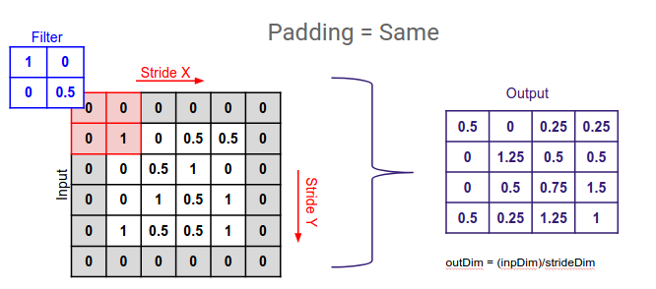
Convolutional Layer - Padding
In CNN padding refers to the amount of pixels added to an image when it is being processed which allows more accurate analysis.
This padding adds some extra space to cover the image which helps the kernel to improve performance.

Slide 35
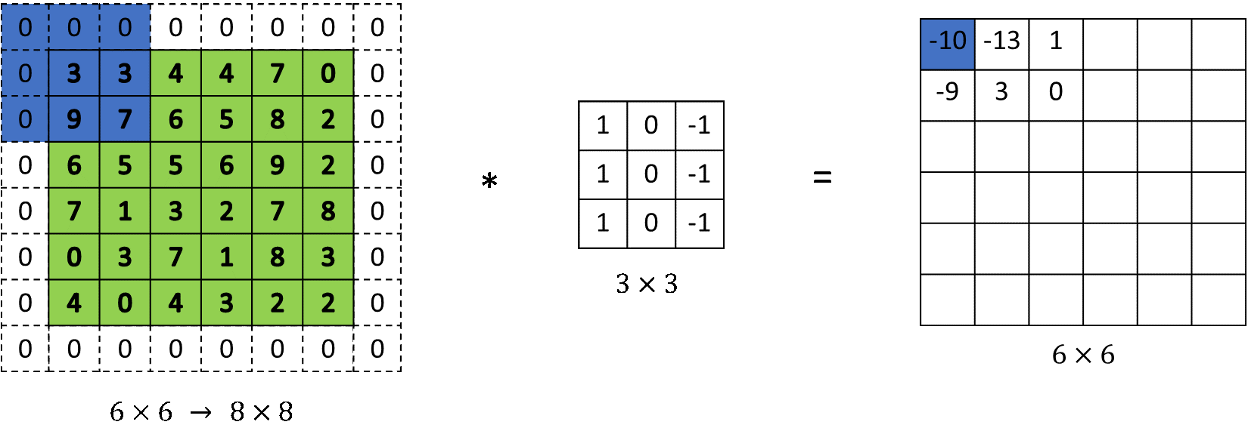
Convolutional Layer - Padding
Sometimes it is convenient to pad the input volume with zeros around the border.
Zero padding is allows us to preserve the spatial size of the output volumes

Slide 36
Convolutional Layer – Filters – Navigation Example
Strides = 1, Filter Size = 3 X 3 X 1, Padding = 0
1 | -1 | -1
-1 | 1 | -1
-1 | -1 | 1
-1 | -1 | -1 | -1 | -1 | -1 | -1 | -1 | -1
-1 | 1 | -1 | -1 | -1 | -1 | -1 | 1 | -1
-1 | -1 | 1 | -1 | -1 | -1 | 1 | -1 | -1
-1 | -1 | -1 | 1 | -1 | 1 | -1 | -1 | -1
-1 | -1 | -1 | -1 | 1 | -1 | -1 | -1 | -1
-1 | -1 | -1 | 1 | -1 | 1 | -1 | -1 | -1
-1 | -1 | 1 | -1 | -1 | -1 | 1 | -1 | -1
-1 | 1 | -1 | -1 | -1 | -1 | -1 | 1 | -1
-1 | -1 | -1 | -1 | -1 | -1 | -1 | -1 | -1

Slide 37
Convolutional Layer – Filters – Navigation Example
1 | -1 | -1
-1 | 1 | -1
-1 | -1 | 1
-1 | -1 | -1 | -1 | -1 | -1 | -1 | -1 | -1
-1 | 1 | -1 | -1 | -1 | -1 | -1 | 1 | -1
-1 | -1 | 1 | -1 | -1 | -1 | 1 | -1 | -1
-1 | -1 | -1 | 1 | -1 | 1 | -1 | -1 | -1
-1 | -1 | -1 | -1 | 1 | -1 | -1 | -1 | -1
-1 | -1 | -1 | 1 | -1 | 1 | -1 | -1 | -1
-1 | -1 | 1 | -1 | -1 | -1 | 1 | -1 | -1
-1 | 1 | -1 | -1 | -1 | -1 | -1 | 1 | -1
-1 | -1 | -1 | -1 | -1 | -1 | -1 | -1 | -1

Slide 38
Convolutional Layer – Filters – Navigation Example
1 | -1 | -1
-1 | 1 | -1
-1 | -1 | 1
-1 | -1 | -1 | -1 | -1 | -1 | -1 | -1 | -1
-1 | 1 | -1 | -1 | -1 | -1 | -1 | 1 | -1
-1 | -1 | 1 | -1 | -1 | -1 | 1 | -1 | -1
-1 | -1 | -1 | 1 | -1 | 1 | -1 | -1 | -1
-1 | -1 | -1 | -1 | 1 | -1 | -1 | -1 | -1
-1 | -1 | -1 | 1 | -1 | 1 | -1 | -1 | -1
-1 | -1 | 1 | -1 | -1 | -1 | 1 | -1 | -1
-1 | 1 | -1 | -1 | -1 | -1 | -1 | 1 | -1
-1 | -1 | -1 | -1 | -1 | -1 | -1 | -1 | -1

Slide 39
Convolutional Layer – Filters – Navigation Example
1 | -1 | -1
-1 | 1 | -1
-1 | -1 | 1
-1 | -1 | -1 | -1 | -1 | -1 | -1 | -1 | -1
-1 | 1 | -1 | -1 | -1 | -1 | -1 | 1 | -1
-1 | -1 | 1 | -1 | -1 | -1 | 1 | -1 | -1
-1 | -1 | -1 | 1 | -1 | 1 | -1 | -1 | -1
-1 | -1 | -1 | -1 | 1 | -1 | -1 | -1 | -1
-1 | -1 | -1 | 1 | -1 | 1 | -1 | -1 | -1
-1 | -1 | 1 | -1 | -1 | -1 | 1 | -1 | -1
-1 | 1 | -1 | -1 | -1 | -1 | -1 | 1 | -1
-1 | -1 | -1 | -1 | -1 | -1 | -1 | -1 | -1

Slide 40
Convolutional Layer – Filters – Navigation Example
1 | -1 | -1
-1 | 1 | -1
-1 | -1 | 1
-1 | -1 | -1 | -1 | -1 | -1 | -1 | -1 | -1
-1 | 1 | -1 | -1 | -1 | -1 | -1 | 1 | -1
-1 | -1 | 1 | -1 | -1 | -1 | 1 | -1 | -1
-1 | -1 | -1 | 1 | -1 | 1 | -1 | -1 | -1
-1 | -1 | -1 | -1 | 1 | -1 | -1 | -1 | -1
-1 | -1 | -1 | 1 | -1 | 1 | -1 | -1 | -1
-1 | -1 | 1 | -1 | -1 | -1 | 1 | -1 | -1
-1 | 1 | -1 | -1 | -1 | -1 | -1 | 1 | -1
-1 | -1 | -1 | -1 | -1 | -1 | -1 | -1 | -1

Slide 41
Convolutional Layer – Filters – Navigation Example
1 | -1 | -1
-1 | 1 | -1
-1 | -1 | 1
-1 | -1 | -1 | -1 | -1 | -1 | -1 | -1 | -1
-1 | 1 | -1 | -1 | -1 | -1 | -1 | 1 | -1
-1 | -1 | 1 | -1 | -1 | -1 | 1 | -1 | -1
-1 | -1 | -1 | 1 | -1 | 1 | -1 | -1 | -1
-1 | -1 | -1 | -1 | 1 | -1 | -1 | -1 | -1
-1 | -1 | -1 | 1 | -1 | 1 | -1 | -1 | -1
-1 | -1 | 1 | -1 | -1 | -1 | 1 | -1 | -1
-1 | 1 | -1 | -1 | -1 | -1 | -1 | 1 | -1
-1 | -1 | -1 | -1 | -1 | -1 | -1 | -1 | -1

Slide 42
Convolutional Layer – Filters – Navigation Example
1 | -1 | -1
-1 | 1 | -1
-1 | -1 | 1
-1 | -1 | -1 | -1 | -1 | -1 | -1 | -1 | -1
-1 | 1 | -1 | -1 | -1 | -1 | -1 | 1 | -1
-1 | -1 | 1 | -1 | -1 | -1 | 1 | -1 | -1
-1 | -1 | -1 | 1 | -1 | 1 | -1 | -1 | -1
-1 | -1 | -1 | -1 | 1 | -1 | -1 | -1 | -1
-1 | -1 | -1 | 1 | -1 | 1 | -1 | -1 | -1
-1 | -1 | 1 | -1 | -1 | -1 | 1 | -1 | -1
-1 | 1 | -1 | -1 | -1 | -1 | -1 | 1 | -1
-1 | -1 | -1 | -1 | -1 | -1 | -1 | -1 | -1

Slide 43
Convolutional Layer – Filters – Navigation Example
1 | -1 | -1
-1 | 1 | -1
-1 | -1 | 1
-1 | -1 | -1 | -1 | -1 | -1 | -1 | -1 | -1
-1 | 1 | -1 | -1 | -1 | -1 | -1 | 1 | -1
-1 | -1 | 1 | -1 | -1 | -1 | 1 | -1 | -1
-1 | -1 | -1 | 1 | -1 | 1 | -1 | -1 | -1
-1 | -1 | -1 | -1 | 1 | -1 | -1 | -1 | -1
-1 | -1 | -1 | 1 | -1 | 1 | -1 | -1 | -1
-1 | -1 | 1 | -1 | -1 | -1 | 1 | -1 | -1
-1 | 1 | -1 | -1 | -1 | -1 | -1 | 1 | -1
-1 | -1 | -1 | -1 | -1 | -1 | -1 | -1 | -1

Slide 44
Convolutional Layer – Filters – Navigation Example
1 | -1 | -1
-1 | 1 | -1
-1 | -1 | 1
-1 | -1 | -1 | -1 | -1 | -1 | -1 | -1 | -1
-1 | 1 | -1 | -1 | -1 | -1 | -1 | 1 | -1
-1 | -1 | 1 | -1 | -1 | -1 | 1 | -1 | -1
-1 | -1 | -1 | 1 | -1 | 1 | -1 | -1 | -1
-1 | -1 | -1 | -1 | 1 | -1 | -1 | -1 | -1
-1 | -1 | -1 | 1 | -1 | 1 | -1 | -1 | -1
-1 | -1 | 1 | -1 | -1 | -1 | 1 | -1 | -1
-1 | 1 | -1 | -1 | -1 | -1 | -1 | 1 | -1
-1 | -1 | -1 | -1 | -1 | -1 | -1 | -1 | -1

Slide 45

Convolutional Layer – Filters – Computation Example
1 | -1 | -1
-1 | 1 | -1
-1 | -1 | 1
-1 | -1 | -1 | -1 | -1 | -1 | -1 | -1 | -1
-1 | 1 | -1 | -1 | -1 | -1 | -1 | 1 | -1
-1 | -1 | 1 | -1 | -1 | -1 | 1 | -1 | -1
-1 | -1 | -1 | 1 | -1 | 1 | -1 | -1 | -1
-1 | -1 | -1 | -1 | 1 | -1 | -1 | -1 | -1
-1 | -1 | -1 | 1 | -1 | 1 | -1 | -1 | -1
-1 | -1 | 1 | -1 | -1 | -1 | 1 | -1 | -1
-1 | 1 | -1 | -1 | -1 | -1 | -1 | 1 | -1
-1 | -1 | -1 | -1 | -1 | -1 | -1 | -1 | -1

Slide 46
Convolutional Layer – Filters – Computation Example
1 | -1 | -1
-1 | 1 | -1
-1 | -1 | 1
1
-1 | -1 | -1 | -1 | -1 | -1 | -1 | -1 | -1
-1 | 1 | -1 | -1 | -1 | -1 | -1 | 1 | -1
-1 | -1 | 1 | -1 | -1 | -1 | 1 | -1 | -1
-1 | -1 | -1 | 1 | -1 | 1 | -1 | -1 | -1
-1 | -1 | -1 | -1 | 1 | -1 | -1 | -1 | -1
-1 | -1 | -1 | 1 | -1 | 1 | -1 | -1 | -1
-1 | -1 | 1 | -1 | -1 | -1 | 1 | -1 | -1
-1 | 1 | -1 | -1 | -1 | -1 | -1 | 1 | -1
-1 | -1 | -1 | -1 | -1 | -1 | -1 | -1 | -1

Slide 47
Convolutional Layer – Filters – Computation Example
1 | -1 | -1
-1 | 1 | -1
-1 | -1 | 1
1 | 1
-1 x -1 = 1
-1 | -1 | -1 | -1 | -1 | -1 | -1 | -1 | -1
-1 | 1 | -1 | -1 | -1 | -1 | -1 | 1 | -1
-1 | -1 | 1 | -1 | -1 | -1 | 1 | -1 | -1
-1 | -1 | -1 | 1 | -1 | 1 | -1 | -1 | -1
-1 | -1 | -1 | -1 | 1 | -1 | -1 | -1 | -1
-1 | -1 | -1 | 1 | -1 | 1 | -1 | -1 | -1
-1 | -1 | 1 | -1 | -1 | -1 | 1 | -1 | -1
-1 | 1 | -1 | -1 | -1 | -1 | -1 | 1 | -1
-1 | -1 | -1 | -1 | -1 | -1 | -1 | -1 | -1

Slide 48
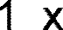

Convolutional Layer – Filters – Computation Example
1 | -1 | -1
-1 | 1 | -1
-1 | -1 | 1
1 | 1 | 1
-1 | -1 | -1 | -1 | -1 | -1 | -1 | -1 | -1
-1 | 1 | -1 | -1 | -1 | -1 | -1 | 1 | -1
-1 | -1 | 1 | -1 | -1 | -1 | 1 | -1 | -1
-1 | -1 | -1 | 1 | -1 | 1 | -1 | -1 | -1
-1 | -1 | -1 | -1 | 1 | -1 | -1 | -1 | -1
-1 | -1 | -1 | 1 | -1 | 1 | -1 | -1 | -1
-1 | -1 | 1 | -1 | -1 | -1 | 1 | -1 | -1
-1 | 1 | -1 | -1 | -1 | -1 | -1 | 1 | -1
-1 | -1 | -1 | -1 | -1 | -1 | -1 | -1 | -1

Slide 49
Convolutional Layer – Filters – Computation Example
1 | -1 | -1
-1 | 1 | -1
-1 | -1 | 1
1 | 1 | 1
1
-1 x -1 = 1
-1 | -1 | -1 | -1 | -1 | -1 | -1 | -1 | -1
-1 | 1 | -1 | -1 | -1 | -1 | -1 | 1 | -1
-1 | -1 | 1 | -1 | -1 | -1 | 1 | -1 | -1
-1 | -1 | -1 | 1 | -1 | 1 | -1 | -1 | -1
-1 | -1 | -1 | -1 | 1 | -1 | -1 | -1 | -1
-1 | -1 | -1 | 1 | -1 | 1 | -1 | -1 | -1
-1 | -1 | 1 | -1 | -1 | -1 | 1 | -1 | -1
-1 | 1 | -1 | -1 | -1 | -1 | -1 | 1 | -1
-1 | -1 | -1 | -1 | -1 | -1 | -1 | -1 | -1

Slide 50
Convolutional Layer – Filters – Computation Example
1 | -1 | -1
-1 | 1 | -1
-1 | -1 | 1
1 x 1 = 1
1 | 1 | 1
1 | 1
-1 | -1 | -1 | -1 | -1 | -1 | -1 | -1 | -1
-1 | 1 | -1 | -1 | -1 | -1 | -1 | 1 | -1
-1 | -1 | 1 | -1 | -1 | -1 | 1 | -1 | -1
-1 | -1 | -1 | 1 | -1 | 1 | -1 | -1 | -1
-1 | -1 | -1 | -1 | 1 | -1 | -1 | -1 | -1
-1 | -1 | -1 | 1 | -1 | 1 | -1 | -1 | -1
-1 | -1 | 1 | -1 | -1 | -1 | 1 | -1 | -1
-1 | 1 | -1 | -1 | -1 | -1 | -1 | 1 | -1
-1 | -1 | -1 | -1 | -1 | -1 | -1 | -1 | -1

Slide 51


Convolutional Layer – Filters – Computation Example
1 | -1 | -1
-1 | 1 | -1
-1 | -1 | 1
1 | 1 | 1
1 | 1 | 1
-1 | -1 | -1 | -1 | -1 | -1 | -1 | -1 | -1
-1 | 1 | -1 | -1 | -1 | -1 | -1 | 1 | -1
-1 | -1 | 1 | -1 | -1 | -1 | 1 | -1 | -1
-1 | -1 | -1 | 1 | -1 | 1 | -1 | -1 | -1
-1 | -1 | -1 | -1 | 1 | -1 | -1 | -1 | -1
-1 | -1 | -1 | 1 | -1 | 1 | -1 | -1 | -1
-1 | -1 | 1 | -1 | -1 | -1 | 1 | -1 | -1
-1 | 1 | -1 | -1 | -1 | -1 | -1 | 1 | -1
-1 | -1 | -1 | -1 | -1 | -1 | -1 | -1 | -1

Slide 52
Convolutional Layer – Filters – Computation Example
1 | -1 | -1
-1 | 1 | -1
-1 | -1 | 1
1 | 1 | 1
1 | 1 | 1
1
-1 x -1 = 1
-1 | -1 | -1 | -1 | -1 | -1 | -1 | -1 | -1
-1 | 1 | -1 | -1 | -1 | -1 | -1 | 1 | -1
-1 | -1 | 1 | -1 | -1 | -1 | 1 | -1 | -1
-1 | -1 | -1 | 1 | -1 | 1 | -1 | -1 | -1
-1 | -1 | -1 | -1 | 1 | -1 | -1 | -1 | -1
-1 | -1 | -1 | 1 | -1 | 1 | -1 | -1 | -1
-1 | -1 | 1 | -1 | -1 | -1 | 1 | -1 | -1
-1 | 1 | -1 | -1 | -1 | -1 | -1 | 1 | -1
-1 | -1 | -1 | -1 | -1 | -1 | -1 | -1 | -1

Slide 53
Convolutional Layer – Filters – Computation Example
1 | -1 | -1
-1 | 1 | -1
-1 | -1 | 1
1 | 1 | 1
1 | 1 | 1
1 | 1
-1 x -1 = 1
-1 | -1 | -1 | -1 | -1 | -1 | -1 | -1 | -1
-1 | 1 | -1 | -1 | -1 | -1 | -1 | 1 | -1
-1 | -1 | 1 | -1 | -1 | -1 | 1 | -1 | -1
-1 | -1 | -1 | 1 | -1 | 1 | -1 | -1 | -1
-1 | -1 | -1 | -1 | 1 | -1 | -1 | -1 | -1
-1 | -1 | -1 | 1 | -1 | 1 | -1 | -1 | -1
-1 | -1 | 1 | -1 | -1 | -1 | 1 | -1 | -1
-1 | 1 | -1 | -1 | -1 | -1 | -1 | 1 | -1
-1 | -1 | -1 | -1 | -1 | -1 | -1 | -1 | -1

Slide 54
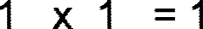
Convolutional Layer – Filters – Computation Example
1 | -1 | -1
-1 | 1 | -1
-1 | -1 | 1
 |  |  |  |  | -1 | -1 | -1 | -1 | -1 | -1 | -1 | -1 | -1
 |  |  |  |  | -1 | 1 | -1 | -1 | -1 | -1 | -1 | 1 | -1
 |  |  |  |  | -1 | -1 | 1 | -1 | -1 | -1 | 1 | -1 | -1
 |  |  |  |  | -1 | -1 | -1 | 1 | -1 | 1 | -1 | -1 | -1
 |  |  |  |  | -1 | -1 | -1 | -1 | 1 | -1 | -1 | -1 | -1
 |  |  |  |  | -1 | -1 | -1 | 1 | -1 | 1 | -1 | -1 | -1
 |  |  |  |  | -1 | -1 | 1 | -1 | -1 | -1 | 1 | -1 | -1
 |  |  |  |  | -1 | 1 | -1 | -1 | -1 | -1 | -1 | 1 | -1
 |  |  |  |  | -1 | -1 | -1 | -1 | -1 | -1 | -1 | -1 | -1
1 | 1 | 1
1 | 1 | 1
1 | 1 | 1

Slide 55
Convolutional Layer – Filters – Computation Example
1 | -1 | -1
-1 | 1 | -1
-1 | -1 | 1
1 | 1 | 1
1 | 1 | 1
1 | 1 | 1
-1 | -1 | -1 | -1 | -1 | -1 | -1 | -1 | -1
-1 | 1 | -1 | -1 | -1 | -1 | -1 | 1 | -1
-1 | -1 | 1 | -1 | -1 | -1 | 1 | -1 | -1 |  |  |  | 1
-1 | -1 | -1 | 1 | -1 | 1 | -1 | -1 | -1
-1 | -1 | -1 | -1 | 1 | -1 | -1 | -1 | -1
-1 | -1 | -1 | 1 | -1 | 1 | -1 | -1 | -1
-1 | -1 | 1 | -1 | -1 | -1 | 1 | -1 | -1
-1 | 1 | -1 | -1 | -1 | -1 | -1 | 1 | -1
-1 | -1 | -1 | -1 | -1 | -1 | -1 | -1 | -1

Slide 56
Convolutional Layer – Filters – Computation Example
1 | -1 | -1
-1 | 1 | -1
-1 | -1 | 1
 |  |  |  | -1 | -1 | -1 | -1 | -1 | -1 | -1 | -1 | -1
 |  |  |  | -1 | 1 | -1 | -1 | -1 | -1 | -1 | 1 | -1
 |  |  |  | -1 | -1 | 1 | -1 | -1 | -1 | 1 | -1 | -1
 |  |  |  | -1 | -1 | -1 | 1 | -1 | 1 | -1 | -1 | -1
 |  |  |  | -1 | -1 | -1 | -1 | 1 | -1 | -1 | -1 | -1
 |  |  |  | -1 | -1 | -1 | 1 | -1 | 1 | -1 | -1 | -1
 |  |  |  | -1 | -1 | 1 | -1 | -1 | -1 | 1 | -1 | -1
 |  |  |  | -1 | 1 | -1 | -1 | -1 | -1 | -1 | 1 | -1
 |  |  |  | -1 | -1 | -1 | -1 | -1 | -1 | -1 | -1 | -1
1

Slide 57

Convolutional Layer – Filters – Computation Example
1 | -1 | -1
-1 | 1 | -1
-1 | -1 | 1
1 | 1 | -1
-1 | -1 | -1 | -1 | -1 | -1 | -1 | -1 | -1
-1 | 1 | -1 | -1 | -1 | -1 | -1 | 1 | -1
-1 | -1 | 1 | -1 | -1 | -1 | 1 | -1 | -1
-1 | -1 | -1 | 1 | -1 | 1 | -1 | -1 | -1
-1 | -1 | -1 | -1 | 1 | -1 | -1 | -1 | -1
-1 | -1 | -1 | 1 | -1 | 1 | -1 | -1 | -1
-1 | -1 | 1 | -1 | -1 | -1 | 1 | -1 | -1
-1 | 1 | -1 | -1 | -1 | -1 | -1 | 1 | -1
-1 | -1 | -1 | -1 | -1 | -1 | -1 | -1 | -1

Slide 58
Convolutional Layer – Filters – Computation Example
1 | -1 | -1
-1 | 1 | -1
-1 | -1 | 1
1 | 1 | -1
1 | 1 | 1
-1 | 1 | 1
-1 | -1 | -1 | -1 | -1 | -1 | -1 | -1 | -1
-1 | 1 | -1 | -1 | -1 | -1 | -1 | 1 | -1
-1 | -1 | 1 | -1 | -1 | -1 | 1 | -1 | -1
-1 | -1 | -1 | 1 | -1 | 1 | -1 | -1 | -1
-1 | -1 | -1 | -1 | 1 | -1 | -1 | -1 | -1
-1 | -1 | -1 | 1 | -1 | 1 | -1 | -1 | -1
-1 | -1 | 1 | -1 | -1 | -1 | 1 | -1 | -1
-1 | 1 | -1 | -1 | -1 | -1 | -1 | 1 | -1
-1 | -1 | -1 | -1 | -1 | -1 | -1 | -1 | -1

Slide 59
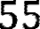
Convolutional Layer – Filters – Computation Example
1 | -1 | -1
-1 | 1 | -1
-1 | -1 | 1
1 1
-1
1 1
-1
1 1 1
1 1 1
-1
1
1
-1
1 1
-1 | -1 | -1 | -1 | -1 | -1 | -1 | -1 | -1
-1 | 1 | -1 | -1 | -1 | -1 | -1 | 1 | -1
-1 | -1 | 1 | -1 | -1 | -1 | 1 | -1 | -1 |  |  |  | 1
-1 | -1 | -1 | 1 | -1 | 1 | -1 | -1 | -1
-1 | -1 | -1 | -1 | 1 | -1 | -1 | -1 | -1 |  |  |  |  |  | 55
-1 | -1 | -1 | 1 | -1 | 1 | -1 | -1 | -1
-1 | -1 | 1 | -1 | -1 | -1 | 1 | -1 | -1
-1 | 1 | -1 | -1 | -1 | -1 | -1 | 1 | -1
-1 | -1 | -1 | -1 | -1 | -1 | -1 | -1 | -1

Slide 60
Convolutional Layer – Filters – Computation Example
Input Size (W): 9 Filter Size (F): 3 X 3
Stride (S): 1
Filters: 1
9 X 9
7 X 7
Padding (P): 0
-1 | -1 | -1 | -1 | -1 | -1 | -1 | -1 | -1
-1 | 1 | -1 | -1 | -1 | -1 | -1 | 1 | -1
-1 | -1 | 1 | -1 | -1 | -1 | 1 | -1 | -1
-1 | -1 | -1 | 1 | -1 | 1 | -1 | -1 | -1
-1 | -1 | -1 | -1 | 1 | -1 | -1 | -1 | -1
-1 | -1 | -1 | 1 | -1 | 1 | -1 | -1 | -1
-1 | -1 | 1 | -1 | -1 | -1 | 1 | -1 | -1
-1 | 1 | -1 | -1 | -1 | -1 | -1 | 1 | -1
-1 | -1 | -1 | -1 | -1 | -1 | -1 | -1 | -1
0.77 | -0.11 | 0.11 | 0.33 | 0.55 | -0.11 | 0.33
-0.11 | 1.00 | -0.11 | 0.33 | -0.11 | 0.11 | -0.11
0.11 | -0.11 | 1.00 | -0.33 | 0.11 | -0.11 | 0.55
0.33 | 0.33 | -0.33 | 0.55 | -0.33 | 0.33 | 0.33
0.55 | -0.11 | 0.11 | -0.33 | 1.00 | -0.11 | 0.11
-0.11 | 0.11 | -0.11 | 0.33 | -0.11 | 1.00 | -0.11
0.33 | -0.11 | 0.55 | 0.33 | 0.11 | -0.11 | 0.77
1 | -1 | -1
-1 | 1 | -1
-1 | -1 | 1
=
Feature Map Size = 1+ (W – F + 2P)/S
= 1+ (9 – 3 + 2 X 0)/1 = 7

Slide 61
Convolutional Layer – Filters – Output Feature Map
Output Feature Map of One complete convolution:
Filters: 3
Filter Size: 3 X 3
Stride: 1
-1 | -1 | -1 | -1 | -1 | -1 | -1 | -1 | -1
-1 | 1 | -1 | -1 | -1 | -1 | -1 | 1 | -1
-1 | -1 | 1 | -1 | -1 | -1 | 1 | -1 | -1
-1 | -1 | -1 | 1 | -1 | 1 | -1 | -1 | -1
-1 | -1 | -1 | -1 | 1 | -1 | -1 | -1 | -1
-1 | -1 | -1 | 1 | -1 | 1 | -1 | -1 | -1
-1 | -1 | 1 | -1 | -1 | -1 | 1 | -1 | -1
-1 | 1 | -1 | -1 | -1 | -1 | -1 | 1 | -1
-1 | -1 | -1 | -1 | -1 | -1 | -1 | -1 | -1
0.77 | -0.11 | 0.11 | 0.33 | 0.55 | -0.11 | 0.33
-0.11 | 1.00 | -0.11 | 0.33 | -0.11 | 0.11 | -0.11
0.11 | -0.11 | 1.00 | -0.33 | 0.11 | -0.11 | 0.55
0.33 | 0.33 | -0.33 | 0.55 | -0.33 | 0.33 | 0.33
0.55 | -0.11 | 0.11 | -0.33 | 1.00 | -0.11 | 0.11
-0.11 | 0.11 | -0.11 | 0.33 | -0.11 | 1.00 | -0.11
0.33 | -0.11 | 0.55 | 0.33 | 0.11 | -0.11 | 0.77
1 | -1 | -1
-1 | 1 | -1
-1 | -1 | 1
=
-1 | -1 | -1 | -1 | -1 | -1 | -1 | -1 | -1
-1 | 1 | -1 | -1 | -1 | -1 | -1 | 1 | -1
-1 | -1 | 1 | -1 | -1 | -1 | 1 | -1 | -1
-1 | -1 | -1 | 1 | -1 | 1 | -1 | -1 | -1
-1 | -1 | -1 | -1 | 1 | -1 | -1 | -1 | -1
-1 | -1 | -1 | 1 | -1 | 1 | -1 | -1 | -1
-1 | -1 | 1 | -1 | -1 | -1 | 1 | -1 | -1
-1 | 1 | -1 | -1 | -1 | -1 | -1 | 1 | -1
-1 | -1 | -1 | -1 | -1 | -1 | -1 | -1 | -1
0.33 | -0.55 | 0.11 | -0.11 | 0.11 | -0.55 | 0.33
-0.55 | 0.55 | -0.55 | 0.33 | -0.55 | 0.55 | -0.55
0.11 | -0.55 | 0.55 | -0.77 | 0.55 | -0.55 | 0.11
-0.11 | 0.33 | -0.77 | 1.00 | -0.77 | 0.33 | -0.11
0.11 | -0.55 | 0.55 | -0.77 | 0.55 | -0.55 | 0.11
-0.55 | 0.55 | -0.55 | 0.33 | -0.55 | 0.55 | -0.55
0.33 | -0.55 | 0.11 | -0.11 | 0.11 | -0.55 | 0.33
1 | -1 | 1
-1 | 1 | -1
1 | -1 | 1
=
Conclusion:
Input Image:
9 X 9
Output of Convolution:
7 X 7 X 3
-1 | -1 | -1 | -1 | -1 | -1 | -1 | -1 | -1
-1 | 1 | -1 | -1 | -1 | -1 | -1 | 1 | -1
-1 | -1 | 1 | -1 | -1 | -1 | 1 | -1 | -1
-1 | -1 | -1 | 1 | -1 | 1 | -1 | -1 | -1
-1 | -1 | -1 | -1 | 1 | -1 | -1 | -1 | -1
-1 | -1 | -1 | 1 | -1 | 1 | -1 | -1 | -1
-1 | -1 | 1 | -1 | -1 | -1 | 1 | -1 | -1
-1 | 1 | -1 | -1 | -1 | -1 | -1 | 1 | -1
-1 | -1 | -1 | -1 | -1 | -1 | -1 | -1 | -1
0.33 | -0.11 | 0.55 | 0.33 | 0.11 | -0.11 | 0.77
-0.11 | 0.11 | -0.11 | 0.33 | -0.11 | 1.00 | -0.11
0.55 | -0.11 | 0.11 | -0.33 | 1.00 | -0.11 | 0.11
0.33 | 0.33 | -0.33 | 0.55 | -0.33 | 0.33 | 0.33
0.11 | -0.11 | 1.00 | -0.33 | 0.11 | -0.11 | 0.55
-0.11 | 1.00 | -0.11 | 0.33 | -0.11 | 0.11 | -0.11
0.77 | -0.11 | 0.11 | 0.33 | 0.55 | -0.11 | 0.33
-1 | -1 | 1
-1 | 1 | -1
1 | -1 | -1
=

Slide 62
Convolutional Layer – Output
0.77 | -0.11 | 0.11 | 0.33 | 0.55 | -0.11 | 0.33
-0.11 | 1.00 | -0.11 | 0.33 | -0.11 | 0.11 | -0.11
0.11 | -0.11 | 1.00 | -0.33 | 0.11 | -0.11 | 0.55
0.33 | 0.33 | -0.33 | 0.55 | -0.33 | 0.33 | 0.33
0.55 | -0.11 | 0.11 | -0.33 | 1.00 | -0.11 | 0.11
-0.11 | 0.11 | -0.11 | 0.33 | -0.11 | 1.00 | -0.11
0.33 | -0.11 | 0.55 | 0.33 | 0.11 | -0.11 | 0.77
-1 | -1 | -1 | -1 | -1 | -1 | -1 | -1 | -1
-1 | 1 | -1 | -1 | -1 | -1 | -1 | 1 | -1
-1 | -1 | 1 | -1 | -1 | -1 | 1 | -1 | -1
-1 | -1 | -1 | 1 | -1 | 1 | -1 | -1 | -1
-1 | -1 | -1 | -1 | 1 | -1 | -1 | -1 | -1
-1 | -1 | -1 | 1 | -1 | 1 | -1 | -1 | -1
-1 | -1 | 1 | -1 | -1 | -1 | 1 | -1 | -1
-1 | 1 | -1 | -1 | -1 | -1 | -1 | 1 | -1
-1 | -1 | -1 | -1 | -1 | -1 | -1 | -1 | -1
0.33 | -0.55 | 0.11 | -0.11 | 0.11 | -0.55 | 0.33
-0.55 | 0.55 | -0.55 | 0.33 | -0.55 | 0.55 | -0.55
0.11 | -0.55 | 0.55 | -0.77 | 0.55 | -0.55 | 0.11
-0.11 | 0.33 | -0.77 | 1.00 | -0.77 | 0.33 | -0.11
0.11 | -0.55 | 0.55 | -0.77 | 0.55 | -0.55 | 0.11
-0.55 | 0.55 | -0.55 | 0.33 | -0.55 | 0.55 | -0.55
0.33 | -0.55 | 0.11 | -0.11 | 0.11 | -0.55 | 0.33
0.33 | -0.11 | 0.55 | 0.33 | 0.11 | -0.11 | 0.77
-0.11 | 0.11 | -0.11 | 0.33 | -0.11 | 1.00 | -0.11
0.55 | -0.11 | 0.11 | -0.33 | 1.00 | -0.11 | 0.11
0.33 | 0.33 | -0.33 | 0.55 | -0.33 | 0.33 | 0.33
0.11 | -0.11 | 1.00 | -0.33 | 0.11 | -0.11 | 0.55
-0.11 | 1.00 | -0.11 | 0.33 | -0.11 | 0.11 | -0.11
0.77 | -0.11 | 0.11 | 0.33 | 0.55 | -0.11 | 0.33

Slide 63
Content
Introduction
Architectural Overview
ConvNet Layers
Convolutional Layer
ReLU Layer
Pooling Layer
Fully-connected Layer
Demo

Slide 64
Rectified Linear Units (ReLUs)
Here we will replace the negative values with 0
0.77 | -0.11 | 0.11 | 0.33 | 0.55 | -0.11 | 0.33
-0.11 | 1.00 | -0.11 | 0.33 | -0.11 | 0.11 | -0.11
0.11 | -0.11 | 1.00 | -0.33 | 0.11 | -0.11 | 0.55
0.33 | 0.33 | -0.33 | 0.55 | -0.33 | 0.33 | 0.33
0.55 | -0.11 | 0.11 | -0.33 | 1.00 | -0.11 | 0.11
-0.11 | 0.11 | -0.11 | 0.33 | -0.11 | 1.00 | -0.11
0.33 | -0.11 | 0.55 | 0.33 | 0.11 | -0.11 | 0.77
0.77

Slide 65
Rectified Linear Units (ReLUs)
0.77 | -0.11 | 0.11 | 0.33 | 0.55 | -0.11 | 0.33
-0.11 | 1.00 | -0.11 | 0.33 | -0.11 | 0.11 | -0.11
0.11 | -0.11 | 1.00 | -0.33 | 0.11 | -0.11 | 0.55
0.33 | 0.33 | -0.33 | 0.55 | -0.33 | 0.33 | 0.33
0.55 | -0.11 | 0.11 | -0.33 | 1.00 | -0.11 | 0.11
-0.11 | 0.11 | -0.11 | 0.33 | -0.11 | 1.00 | -0.11
0.33 | -0.11 | 0.55 | 0.33 | 0.11 | -0.11 | 0.77
0.77 0

Slide 66
Rectified Linear Units (ReLUs)
0.77 | -0.11 | 0.11 | 0.33 | 0.55 | -0.11 | 0.33
-0.11 | 1.00 | -0.11 | 0.33 | -0.11 | 0.11 | -0.11
0.11 | -0.11 | 1.00 | -0.33 | 0.11 | -0.11 | 0.55
0.33 | 0.33 | -0.33 | 0.55 | -0.33 | 0.33 | 0.33
0.55 | -0.11 | 0.11 | -0.33 | 1.00 | -0.11 | 0.11
-0.11 | 0.11 | -0.11 | 0.33 | -0.11 | 1.00 | -0.11
0.33 | -0.11 | 0.55 | 0.33 | 0.11 | -0.11 | 0.77
0.77 | 0 | 0.11 | 0.33 | 0.55 | 0 | 0.33

Slide 67
Rectified Linear Units (ReLUs)
0.77 | -0.11 | 0.11 | 0.33 | 0.55 | -0.11 | 0.33
-0.11 | 1.00 | -0.11 | 0.33 | -0.11 | 0.11 | -0.11
0.11 | -0.11 | 1.00 | -0.33 | 0.11 | -0.11 | 0.55
0.33 | 0.33 | -0.33 | 0.55 | -0.33 | 0.33 | 0.33
0.55 | -0.11 | 0.11 | -0.33 | 1.00 | -0.11 | 0.11
-0.11 | 0.11 | -0.11 | 0.33 | -0.11 | 1.00 | -0.11
0.33 | -0.11 | 0.55 | 0.33 | 0.11 | -0.11 | 0.77
 | 0.77 | 0 | 0.11 | 0.33 | 0.55 | 0 | 0.33
 | 0 | 1.00 | 0 | 0.33 | 0 | 0.11 | 0
 | 0.11 | 0 | 1.00 | 0 | 0.11 | 0 | 0.55
 | 0.33 | 0.33 | 0 | 0.55 | 0 | 0.33 | 0.33
 | 0.55 | 0 | 0.11 | 0 | 1.00 | 0 | 0.11
 | 0 | 0.11 | 0 | 0.33 | 0 | 1.00 | 0
 | 0.33 | 0 | 0.55 | 0.33 | 0.11 | 0 | 0.77

Slide 68
ReLU layer
0.77 | -0.11 | 0.11 | 0.33 | 0.55 | -0.11 | 0.33
-0.11 | 1.00 | -0.11 | 0.33 | -0.11 | 0.11 | -0.11
0.11 | -0.11 | 1.00 | -0.33 | 0.11 | -0.11 | 0.55
0.33 | 0.33 | -0.33 | 0.55 | -0.33 | 0.33 | 0.33
0.55 | -0.11 | 0.11 | -0.33 | 1.00 | -0.11 | 0.11
-0.11 | 0.11 | -0.11 | 0.33 | -0.11 | 1.00 | -0.11
0.33 | -0.11 | 0.55 | 0.33 | 0.11 | -0.11 | 0.77
0.77 | 0 | 0.11 | 0.33 | 0.55 | 0 | 0.33
0 | 1.00 | 0 | 0.33 | 0 | 0.11 | 0
0.11 | 0 | 1.00 | 0 | 0.11 | 0 | 0.55
0.33 | 0.33 | 0 | 0.55 | 0 | 0.33 | 0.33
0.55 | 0 | 0.11 | 0 | 1.00 | 0 | 0.11
0 | 0.11 | 0 | 0.33 | 0 | 1.00 | 0
0.33 | 0 | 0.55 | 0.33 | 0.11 | 0 | 0.77
0.33 | -0.55 | 0.11 | -0.11 | 0.11 | -0.55 | 0.33
-0.55 | 0.55 | -0.55 | 0.33 | -0.55 | 0.55 | -0.55
0.11 | -0.55 | 0.55 | -0.77 | 0.55 | -0.55 | 0.11
-0.11 | 0.33 | -0.77 | 1.00 | -0.77 | 0.33 | -0.11
0.11 | -0.55 | 0.55 | -0.77 | 0.55 | -0.55 | 0.11
-0.55 | 0.55 | -0.55 | 0.33 | -0.55 | 0.55 | -0.55
0.33 | -0.55 | 0.11 | -0.11 | 0.11 | -0.55 | 0.33
0.33 | 0 | 0.11 | 0 | 0.11 | 0 | 0.33
0 | 0.55 | 0 | 0.33 | 0 | 0.55 | 0
0.11 | 0 | 0.55 | 0 | 0.55 | 0 | 0.11
0 | 0.33 | 0 1.00 0 |  |  | 0.33 | 0
0.11 | 0 | 0.55 | 0 | 0.55 | 0 | 0.11
0 | 0.55 | 0 | 0.33 | 0 | 0.55 | 0
0.33 | 0 | 0.11 | 0 | 0.11 | 0 | 0.33
0.33 | -0.11 | 0.55 | 0.33 | 0.11 | -0.11 | 0.77
-0.11 | 0.11 | -0.11 | 0.33 | -0.11 | 1.00 | -0.11
0.55 | -0.11 | 0.11 | -0.33 | 1.00 | -0.11 | 0.11
0.33 | 0.33 | -0.33 | 0.55 | -0.33 | 0.33 | 0.33
0.11 | -0.11 | 1.00 | -0.33 | 0.11 | -0.11 | 0.55
-0.11 | 1.00 | -0.11 | 0.33 | -0.11 | 0.11 | -0.11
0.77 | -0.11 | 0.11 | 0.33 | 0.55 | -0.11 | 0.33
0.33 | 0 | 0.55 | 0.33 | 0.11 | 0 | 0.77
0 | 0.11 | 0 | 0.33 | 0 | 1.00 | 0
0.55 | 0 | 0.11 | 0 | 1.00 | 0 | 0.11
0.33 | 0.33 | 0 | 0.55 | 0 | 0.33 | 0.33
0.11 | 0 | 1.00 | 0 | 0.11 | 0 | 0.55
0 | 1.00 | 0 | 0.33 | 0 | 0.11 | 0
0.77 | 0 | 0.11 | 0.33 | 0.55 | 0 | 0.33

Slide 69
Content
Introduction
Architectural Overview
ConvNet Layers
Convolutional Layer
ReLU Layer
Pooling Layer
Fully-connected Layer
Demo

Slide 70
Pooling Layer
The pooling layers down-sample the previous layers feature map.
It's function is to progressively reduce the spatial size of the representation to reduce the amount of parameters and computation in the network
The pooling layer often uses the Max operation to perform the downsampling process

Slide 71

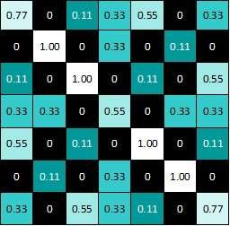
Pooling
Pooling Filter Size = 2 X 2, Stride = 2
1.00

Slide 72
Pooling
Pooling Filter Size = 2 X 2, Stride = 2
1.00 | 0.33

Slide 73
Pooling
Pooling Filter Size = 2 X 2, Stride = 2
1.00 | 0.33 | 0.55

Slide 74
Pooling
Pooling Filter Size = 2 X 2, Stride = 2
1.00 | 0.33 | 0.55 | 0.33

Slide 75
Pooling
Pooling Filter Size = 2 X 2, Stride = 2
1.00 | 0.33 | 0.55 | 0.33
0.33

Slide 76

Pooling
Pooling Filter Size = 2 X 2, Stride = 2
1.00 | 0.33 | 0.55 | 0.33
0.33 | 1.00 | 0.33 | 0.55
0.55 | 0.33 | 1.00 | 0.11
0.33 | 0.55 | 0.11 | 0.77

Slide 77
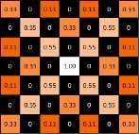
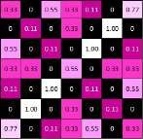
Pooling
1.00 | 0.33 | 0.55 | 0.33
0.33 | 1.00 | 0.33 | 0.55
0.55 | 0.33 | 1.00 | 0.11
0.33 | 0.55 | 0.11 | 0.77
0.55 | 0.33 | 0.55 | 0.33
0.33 | 1.00 | 0.55 | 0.11
0.55 | 0.55 | 0.55 | 0.11
0.33 | 0.11 | 0.11 | 0.33
0.33 | 0.55 | 1.00 | 0.77
0.55 | 0.55 | 1.00 | 0.33
1.00 | 1.00 | 0.11 | 0.55
0.77 | 0.33 | 0.55 | 0.33

Slide 78



Layers get stacked
1.00 | 0.33 | 0.55 | 0.33
0.33 | 1.00 | 0.33 | 0.55
0.55 | 0.33 | 1.00 | 0.11
0.33 | 0.55 | 0.11 | 0.77
-1 | -1 | -1 | -1 | -1 | -1 | -1 | -1 | -1
-1 | 1 | -1 | -1 | -1 | -1 | -1 | 1 | -1
-1 | -1 | 1 | -1 | -1 | -1 | 1 | -1 | -1
-1 | -1 | -1 | 1 | -1 | 1 | -1 | -1 | -1
-1 | -1 | -1 | -1 | 1 | -1 | -1 | -1 | -1
-1 | -1 | -1 | 1 | -1 | 1 | -1 | -1 | -1
-1 | -1 | 1 | -1 | -1 | -1 | 1 | -1 | -1
-1 | 1 | -1 | -1 | -1 | -1 | -1 | 1 | -1
-1 | -1 | -1 | -1 | -1 | -1 | -1 | -1 | -1
0.55 | 0.33 | 0.55 | 0.33
0.33 | 1.00 | 0.55 | 0.11
0.55 | 0.55 | 0.55 | 0.11
0.33 | 0.11 | 0.11 | 0.33
0.33 | 0.55 | 1.00 | 0.77
0.55 | 0.55 | 1.00 | 0.33
1.00 | 1.00 | 0.11 | 0.55
0.77 | 0.33 | 0.55 | 0.33

Slide 79


Layers Get Stacked - Example
224 X 224 X 3
224 X 224 X 64
112 X 112 X 64
CONVOLUTION
WITH 64 FILTERS
POOLING
(DOWNSAMPLING)

Slide 80


Deep stacking
1.00 | 0.55
0.55 | 1.00
-1 | -1 | -1 | -1 | -1 | -1 | -1 | -1 | -1
-1 | 1 | -1 | -1 | -1 | -1 | -1 | 1 | -1
-1 | -1 | 1 | -1 | -1 | -1 | 1 | -1 | -1
-1 | -1 | -1 | 1 | -1 | 1 | -1 | -1 | -1
-1 | -1 | -1 | -1 | 1 | -1 | -1 | -1 | -1
-1 | -1 | -1 | 1 | -1 | 1 | -1 | -1 | -1
-1 | -1 | 1 | -1 | -1 | -1 | 1 | -1 | -1
-1 | 1 | -1 | -1 | -1 | -1 | -1 | 1 | -1
-1 | -1 | -1 | -1 | -1 | -1 | -1 | -1 | -1
1.00 | 0.55
0.55 | 0.55
0.55 | 1.00
1.00 | 0.55

Slide 81
Content
Introduction
Architectural Overview
ConvNet Layers
Convolutional Layer
ReLU Layer
Pooling Layer
Fully-connected Layer
Demo

Slide 82
Fully connected layer
Fully connected layers are the normal flat feed-forward neural network layers.
1.00
0.55
These layers may have a non-linear activation function or a softmax activation in order to predict classes.
0.55
1.00
0.55
0.55
1.00
1.00
1.00
1.00 | 0.55
0.55 | 0.55
0.55
To compute our output, we simply re- arrange the output matrices as a 1-D array.
0.55
0.55 | 1.00
1.00 | 0.55
0.55
0.55
1.00
1.00
0.55

Slide 83
Fully connected layer
A summation of product of inputs and weights at each output node determines the final prediction
0.55
1.00
1.00
0.55
0.55
0.55
0.55
0.55
1.00
0.55
0.55
1.00
O
X

Slide 84








Putting it all together
-1 | -1 | -1 | -1 | -1 | -1 | -1 | -1 | -1
-1 | 1 | -1 | -1 | -1 | -1 | -1 | 1 | -1
-1 | -1 | 1 | -1 | -1 | -1 | 1 | -1 | -1
-1 | -1 | -1 | 1 | -1 | 1 | -1 | -1 | -1
-1 | -1 | -1 | -1 | 1 | -1 | -1 | -1 | -1
-1 | -1 | -1 | 1 | -1 | 1 | -1 | -1 | -1
-1 | -1 | 1 | -1 | -1 | -1 | 1 | -1 | -1
-1 | 1 | -1 | -1 | -1 | -1 | -1 | 1 | -1
-1 | -1 | -1 | -1 | -1 | -1 | -1 | -1 | -1
X

Slide 85
Content
Introduction
Architectural Overview
ConvNet Layers
Convolutional Layer
Pooling Layer
Normalization Layer
Fully-connected Layer
Demo

Slide 86
References
Karpathy, A. (n.d.). CS231n Convolutional Neural Networks for Visual Recognition. Retrieved from http://cs231n.github.io/convolutional-networks/#overview
Rohrer, B. (n.d.). How do Convolutional Neural Networks work?. Retrieved from
http://brohrer.github.io/how_convolutional_neural_networks_work.html
Brownlee, J. (n.d.). Crash Course in Convolutional Neural Networks for Machine Learning. Retrieved from http://machinelearningmastery.com/crash-course-convolutional-neural-networks/
Nervana. (n.d.). Tutorial: Convolutional neural networks. Retrieved from https://www.nervanasys.com/convolutional-neural-networks/

Slide 87

Questions

Slide 88
Thank you!!

